Slide 1

DATA VISUALIZATION

Slide 2
LEARNING OBJECTIVES
Describe why data visualization is important.
Identify the characteristics of a good data visualization.
Understand the correct charts to use in the context.

Slide 3
Visual Communication
Data Visualization
Notes:
TEACHING TIP
Demo / Codealong / Discussion

Slide 4
WHY USE DATA VIZ?
Because of the way the human brain processes information, charts or graphs that visualize large amounts of complex data are easier to understand than spreadsheets or reports.
Data visualization is a quick, easy way to convey concepts.
Summarizes large sets of information.
Information is only useful if it is understood.

Slide 5
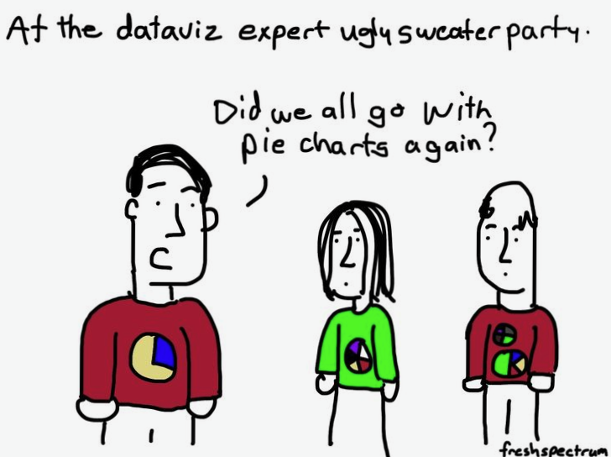

Slide 6
VISUALIZATIONS DON’T HAVE TO BE CHARTS AND GRAPHS
Notes:
This was in WSJ

Slide 7
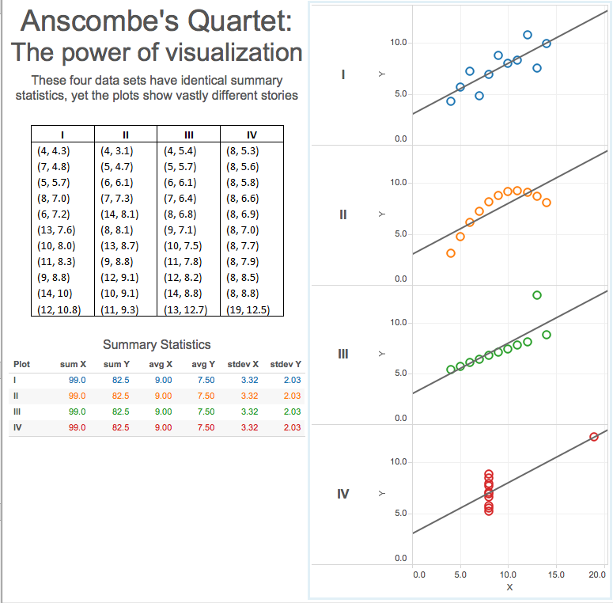
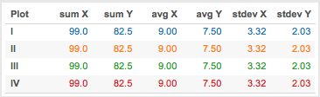
DOWNSIDE OF SUMMARY STATS
Notes:
These descriptive statistics come from a data set constructed in 1973 by the statistician Francis Anscombe. It is a classic demonstration of the importance of data visualization.
Highlights the failures of summary statistics.
Effects of outliers on statistical properties.

Slide 8
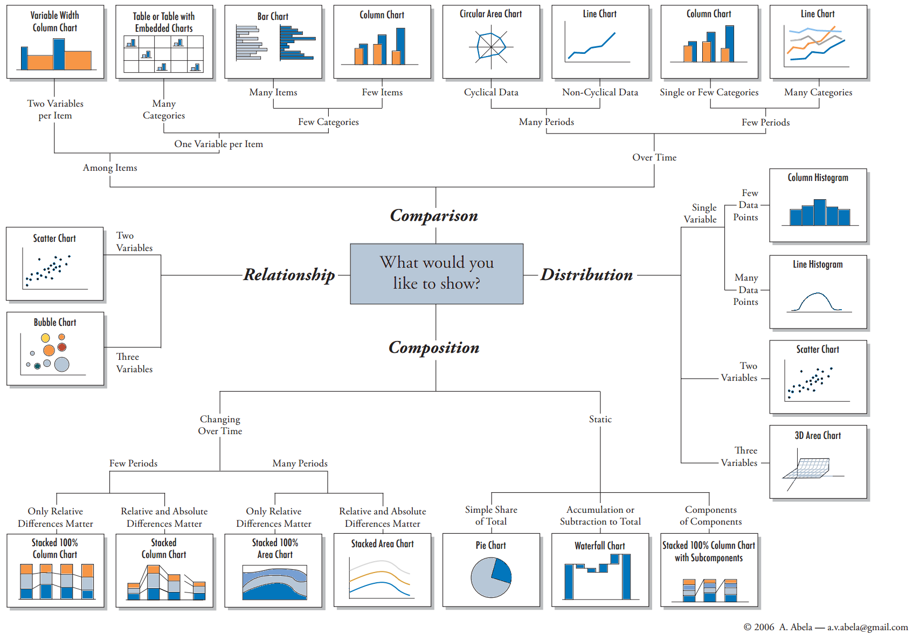
CHOOSING VISUALIZATIONS

Slide 9
GENERAL VISUALIZATION RULES
Before you can effectively visualize data, you first have to understand the preattentive attributes of visual perception.
These attributes — visual qualities like color, size and position — determine what draws our eyes when we look at something new.
Some attributes have more of an effect on our brains than others. The ones we tend to focus on most are position, then color, then size.

Slide 10
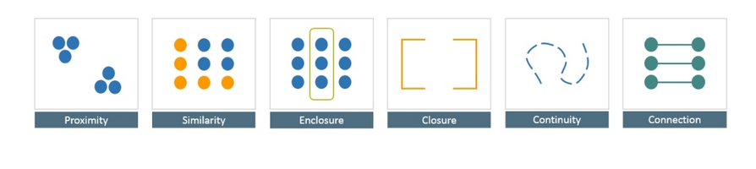
GOOD DESIGN: GESTALT PRINCIPLES
Gestalt Principles (1900s, the Gestalt School of Psychology):
Proximity – Elements nearby tend to be grouped in our minds.
Similarity – Our minds associate similar elements.
Enclosure – If a border surrounds an object, its perceived as a group.
Closure – If something is incomplete (partial border or just axis), it is still perceived as a closed structure.
Continuity – If a number of objects are aligned, we consider them as a continuum.
Connection – If a set of objects are connected, we also see them as a group.
Notes:
TEACHING TIPS:
“Good design–Gestalt principles” (summarized a bit) is from the book “Creating Stunning Dashboards with Qlikview” by Swizec Teller.
KNOWLEDGE CHECK:
How do these design principles connect to the work we’ve been doing?

Slide 11
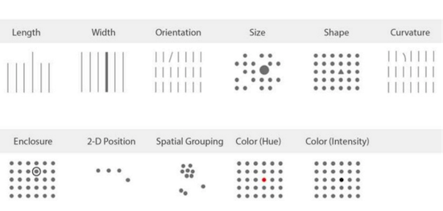
GOOD DESIGN: SHAFFER PRINCIPLES
Notes:
TEACHING TIPS:
“Good design–Gestalt principles” (summarized a bit) is from the book “Creating Stunning Dashboards with Qlikview” by Swizec Teller.
KNOWLEDGE CHECK:
How do these design principles connect to the work we’ve been doing?

Slide 12



WHICH ONE IS MOST EYE CATCHING?

Slide 13
DATA IS BETTER NAKED SERIES
Dark Horse analytics created a series of visuals to demonstrate Edward Tufte's concept of data-ink from his 1983 classic The Visual Display of Quantitative Information. In it Edward states "Data-ink is the non-erasable core of the graphic, the non-redundant ink arranged in response to variation in the numbers represented"
SERIES INTRO
CLEANING UP TABLES
SALVAGING PIE CHARTS
CLEANING UP MAPS
Notes:
TEACHING TIPS:
“Good design–Gestalt principles” (summarized a bit) is from the book “Creating Stunning Dashboards with Qlikview” by Swizec Teller.
KNOWLEDGE CHECK:
How do these design principles connect to the work we’ve been doing?

Slide 14
Color

Slide 15
COLOR
In Data Viz, you will generally use color in one of three ways:
Sequential
Divergent
Categorical

Slide 16
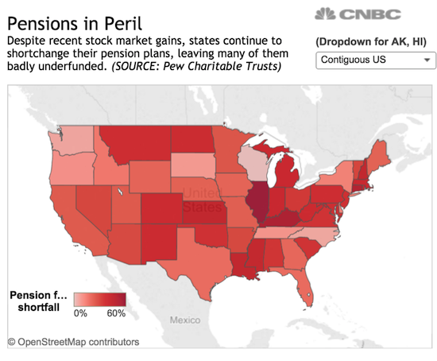
SEQUENTIAL

Slide 17
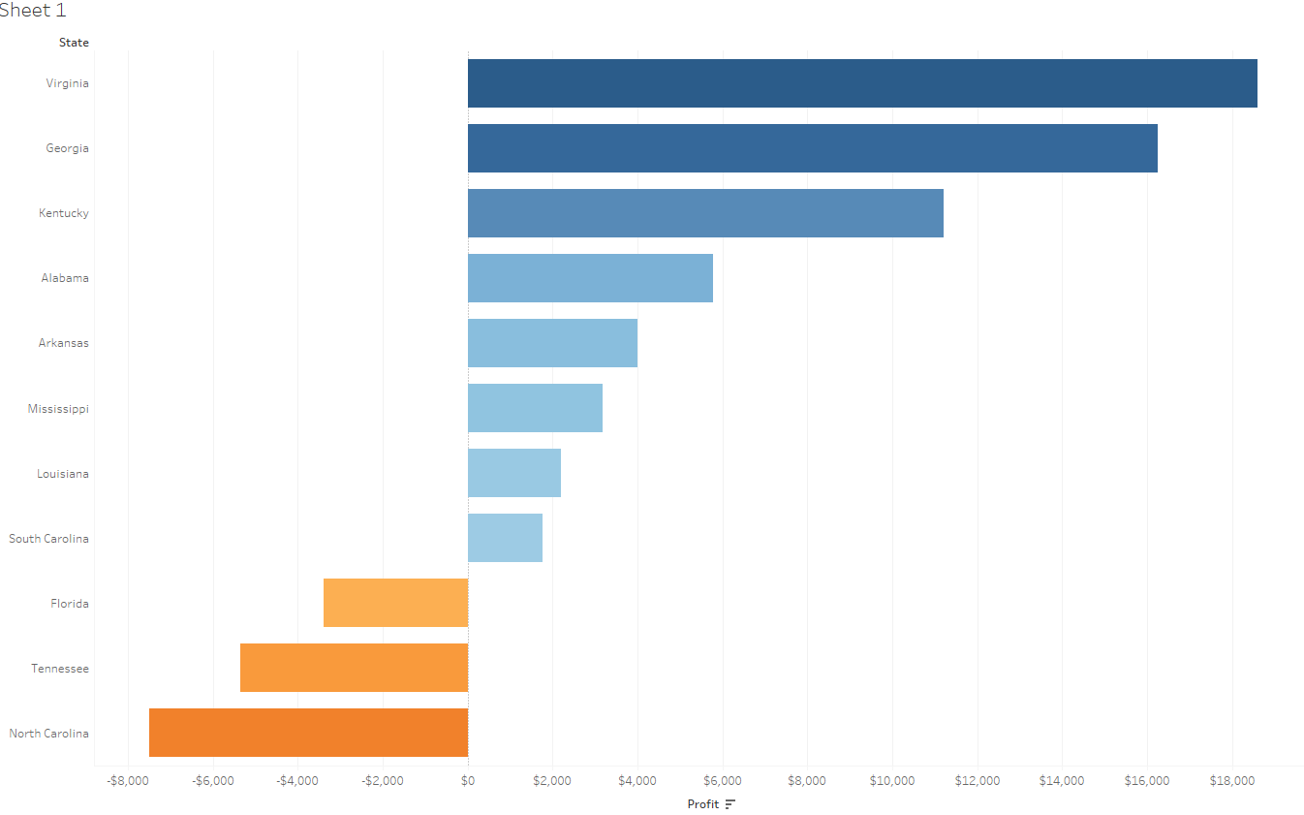
DIVERGENT

Slide 18
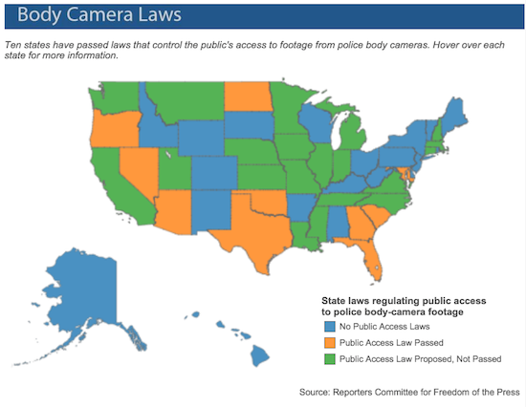
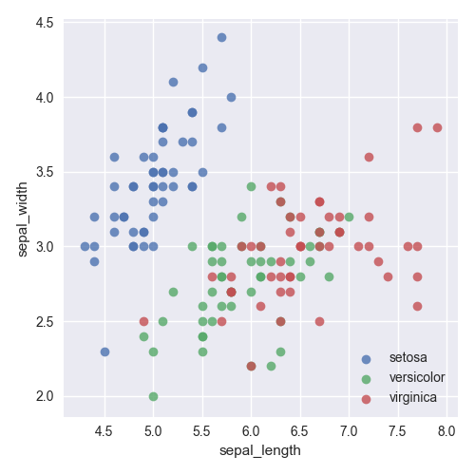
CATEGORICAL

Slide 19
Choosing The Right Chart

Slide 20
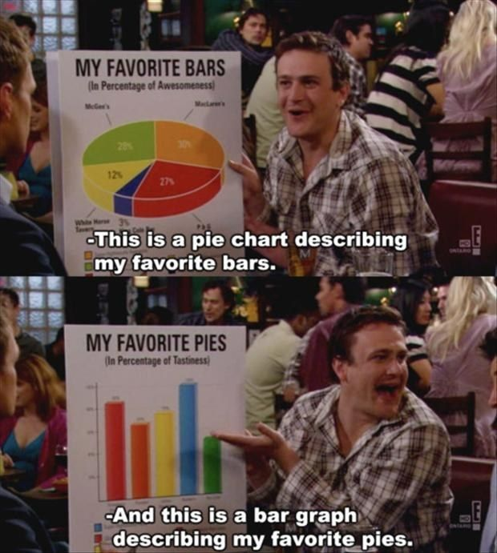

20 | © 2019 General Assembly

Slide 21
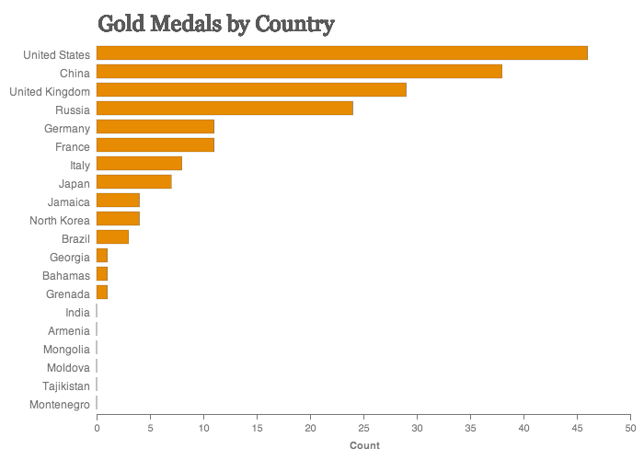
BAR CHARTS
Bar charts are one of the most common ways of visualizing data. Why? Because they make it easy to compare information, revealing highs and lows quickly. They are most effective when you have numerical data that splits neatly into different categories.

Slide 22
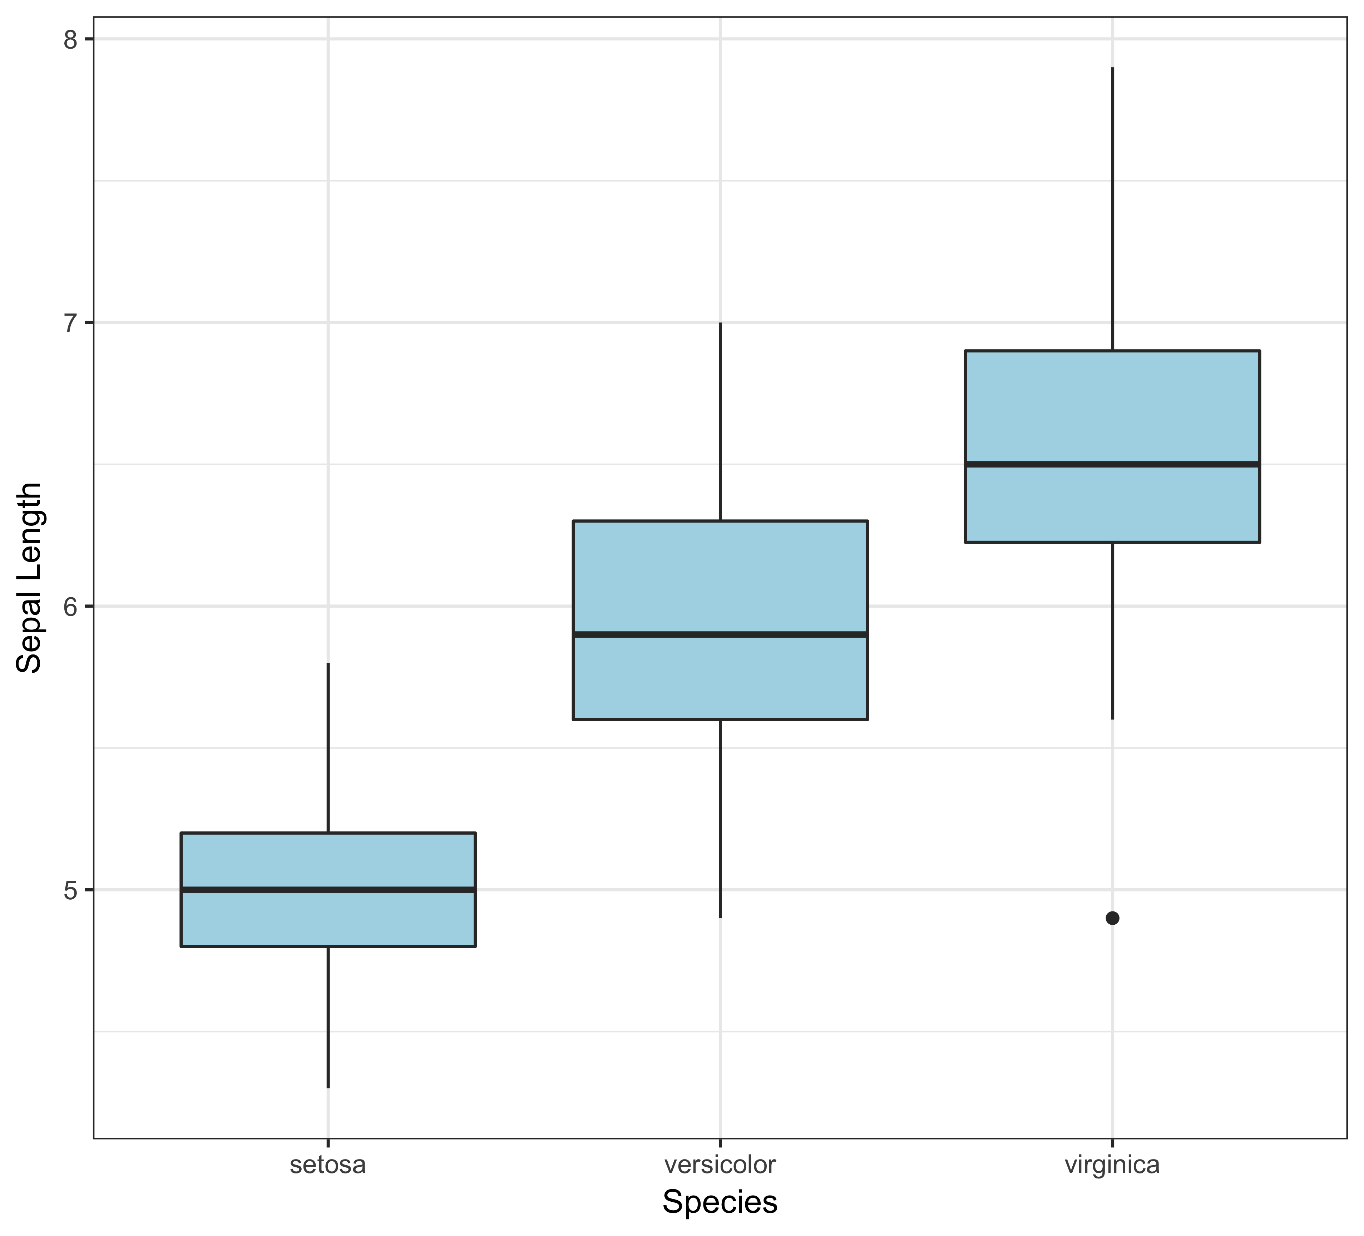
BOX PLOTS
The box plot is suitable for comparing range and distribution for groups of numerical data. It can be of use when you have have a continuous variable in one or more strata and you want to visualize its distribution. It is one of few statistical graph methods that show outliers.

Slide 23
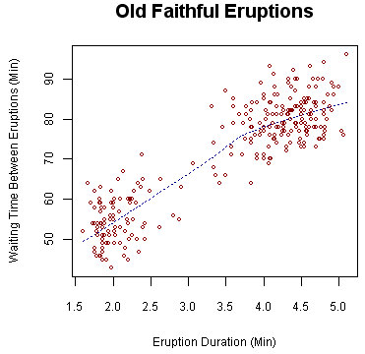
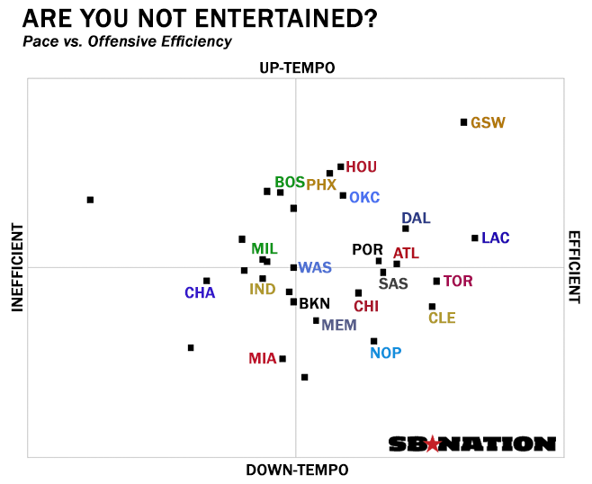
SCATTERPLOTS
Scatter plots are great for showing the relationship between two variables since you can directly see the raw distribution of the data. They provide a sense of trends, concentrations, and outliers.
Notes:
2015 NBA Playoffs

Slide 24
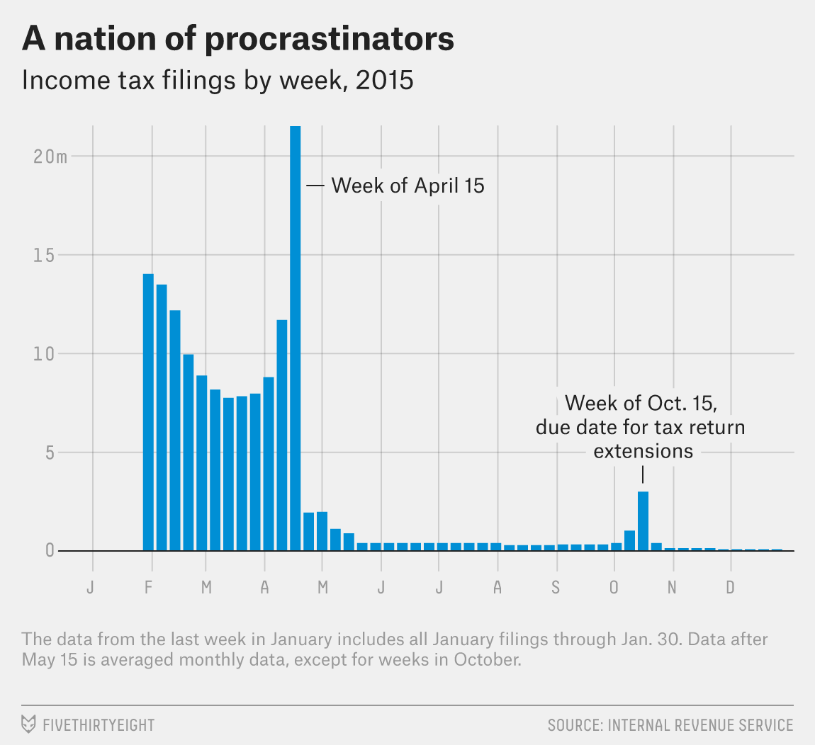
HISTOGRAMS
Histograms are useful when you want to see how your data are distributed across groups/buckets.

Slide 25
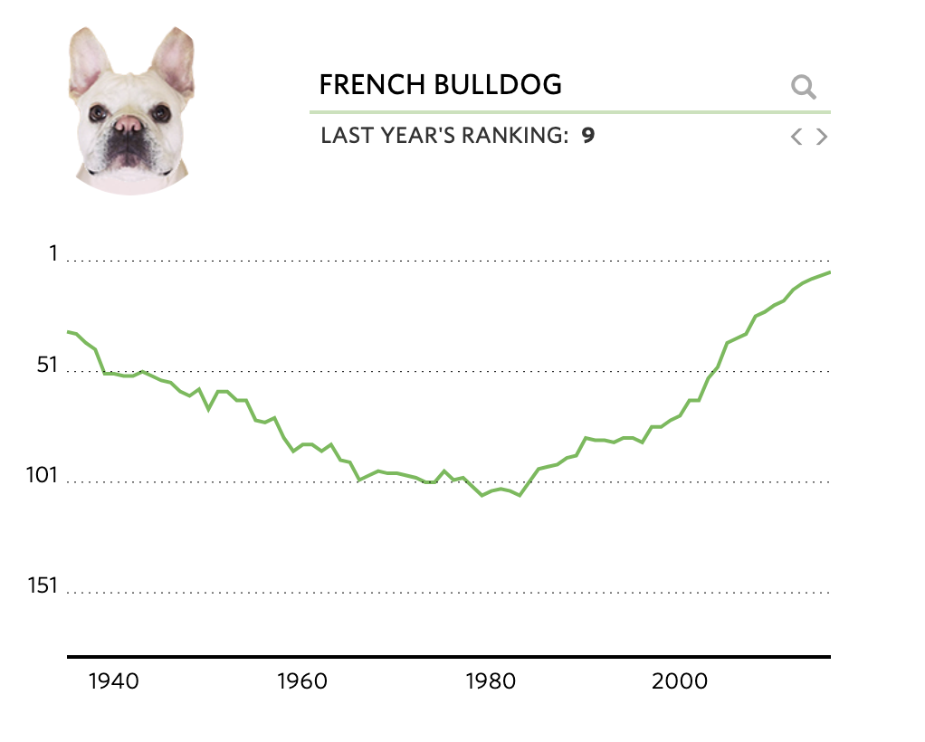
LINE CHARTS
Line charts allow you to see information over time.
Notes:
Dog Popularity: http://graphics.wsj.com/most-popular-dogs/

Slide 26


Slide 27
PIE CHARTS
Pie charts are the most commonly misused chart time.
If you want to compare data, leave it to bars or stacked bars.
If your viewer has to work to translate pie wedges into relevant data or compare pie charts to one another, the key points you're trying to convey might go unnoticed.
Notes:
Dog Popularity: http://graphics.wsj.com/most-popular-dogs/

Slide 28
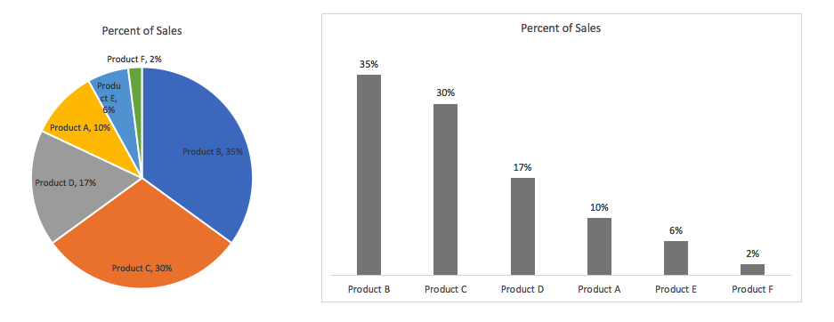
PIE CHARTS
Notes:
Dog Popularity: http://graphics.wsj.com/most-popular-dogs/

Slide 29
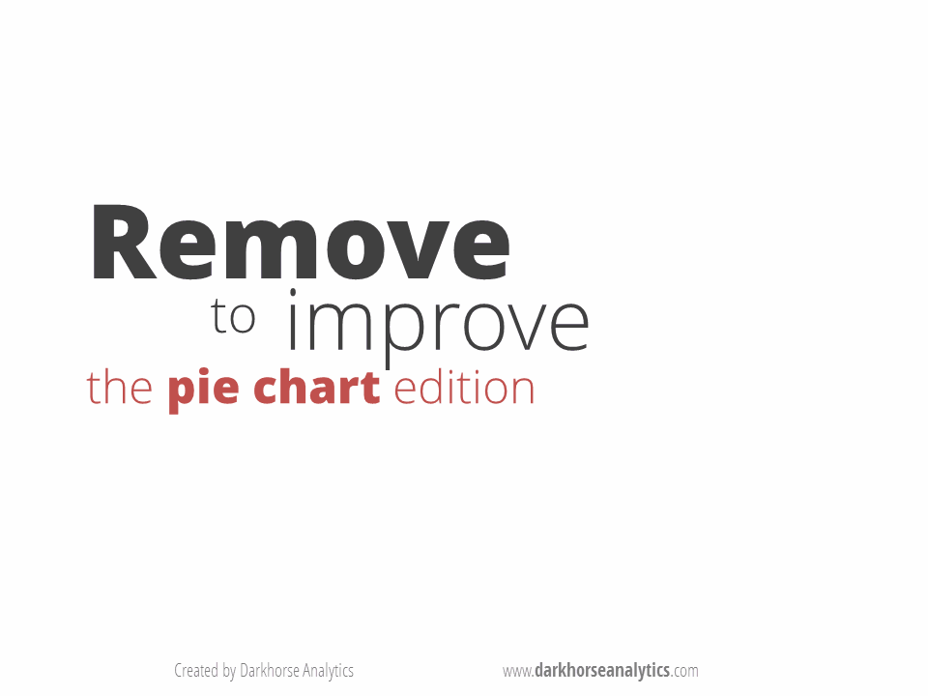
PIE CHARTS

Slide 30
REMEMBER YOUR AUDIENCE
Think about your audience (executive vs. engineer)
Review the contrast and sizing of elements
Consider color-blindness

Slide 31
VISUALIZATION PROGRAMMING LIBRARIES
In this lesson, we will use the Python libraries Matplotlib (Python plotting) and Seaborn (statistical data visualization).
Many other Python libraries exist for making visualizations. Some of the most popular include:
Bokeh: Python visualization library that targets the web browser (e.g., in Jupyter). Makes interactive plots, dashboards, data applications, etc.
Graphviz: Popular visualization library for graph data structures (e.g., edges, vertices, etc.). Has Python extensions.
Basemap: Python Matplotlib extension for drawing static maps. There are many other Python libraries for plotting geographic data, including ones that might be easier to use, but many are not actively developed.
One of the most popular libraries for interactive visualizations in the web browser is D3. Because web browsers only natively run JavaScript, D3 requires knowledge of JavaScript:
D3.js: JavaScript library for interactive web visualizations D3.js | Examples

Slide 32
ADDITIONAL RESOURCES
Perceptual Edge “Cheat Sheet”
Improving Bad Charts
FiveThirtyEight Best and Weirdest Charts in 2018

